Slide 1

ECE 419/619 Electric Machines and Drives
Brushless Dc Drives

Slide 2
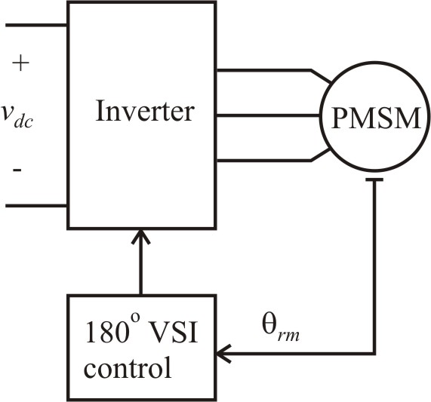
Six-Step Drive Example (Chapter 15)
For desired V_{s}
study 1: V_{s} = 90V so V_{dc} = 200V
study 2: V_{s} = 79.4V so V_{dc} = 176V

Slide 3
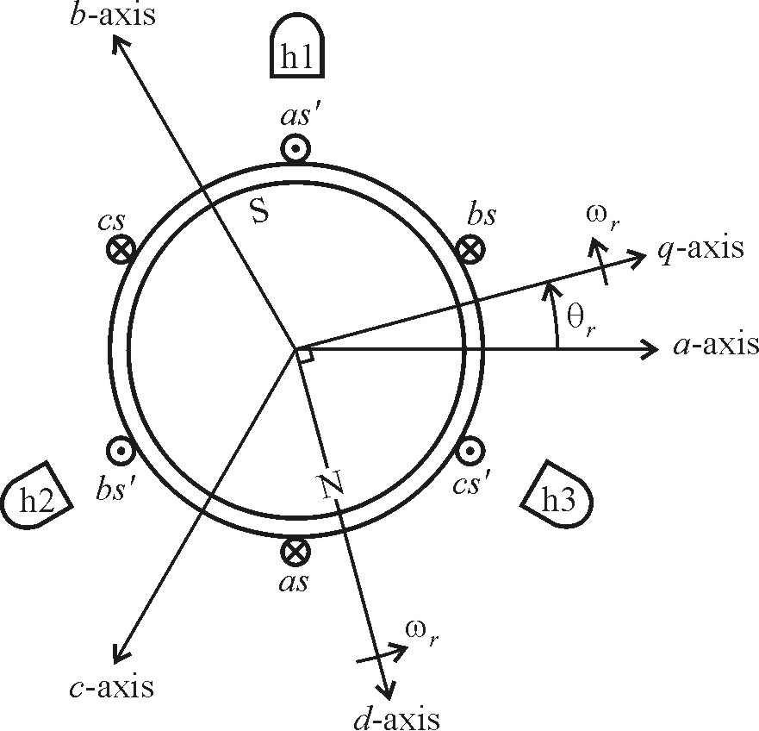
Hall Effect Sensors

Slide 4
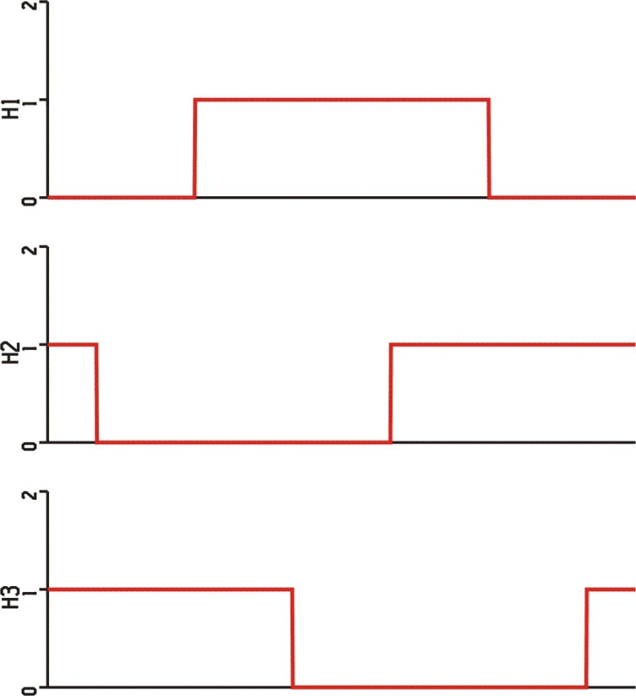
Hall Effect Sensor Signals
For six-step 180º VSI control, set

Slide 5
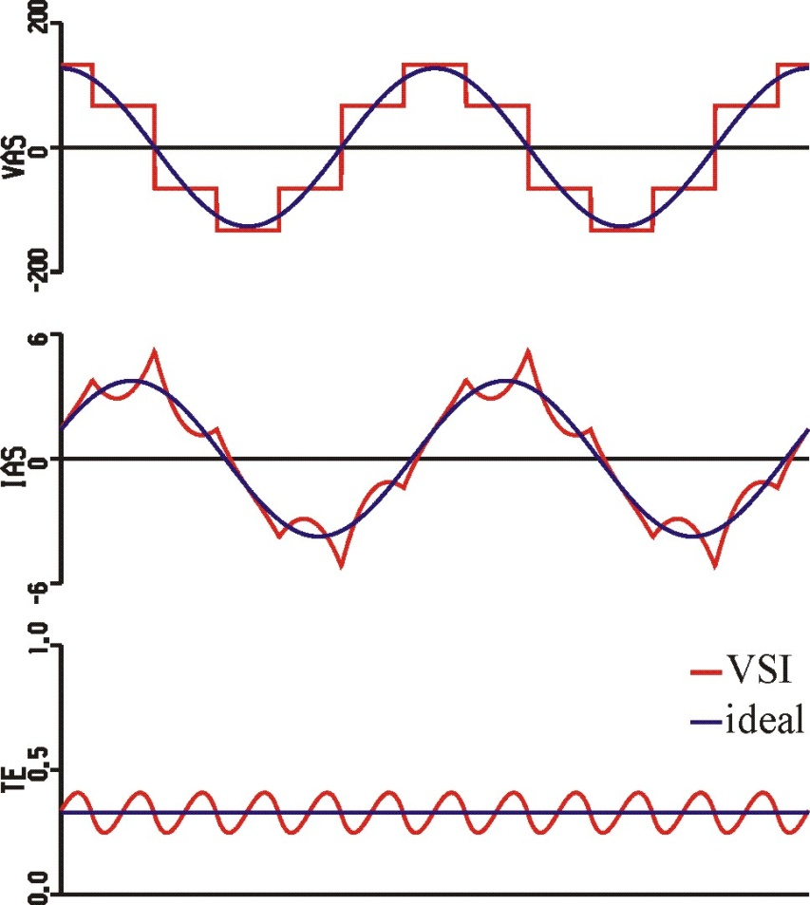
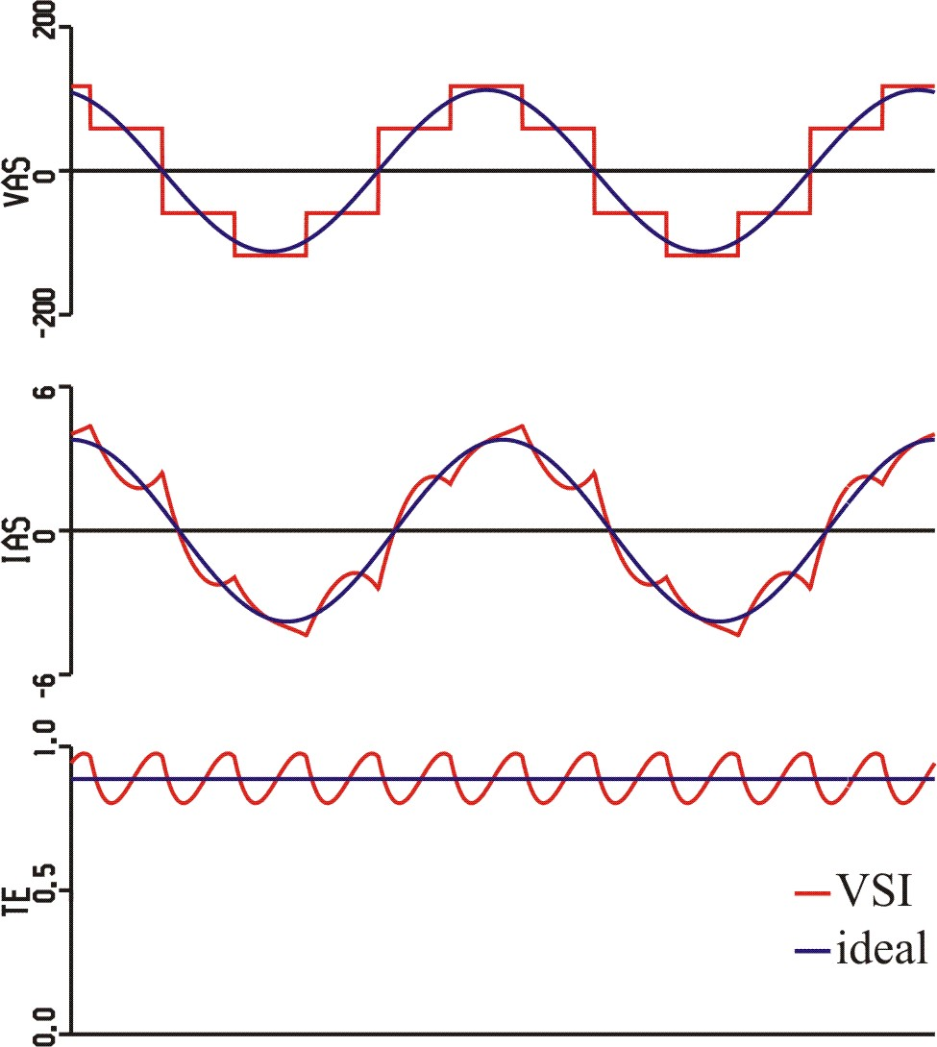
Six-Step Drive Waveforms
φ_{v} = 0
φ_{v} = 14º

Slide 6
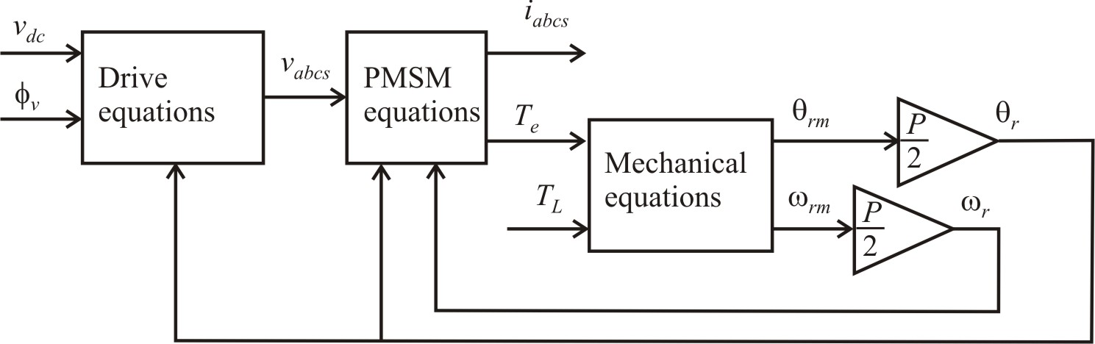
Dynamic Studies
V_{s} = 90V, φ_{v} = 0
motor parameters from previous example
mechanical equations
J = 0.01 kg∙m²
B = 0 kg∙m²/sec
T_{L} = 0.33 N∙m

Slide 7
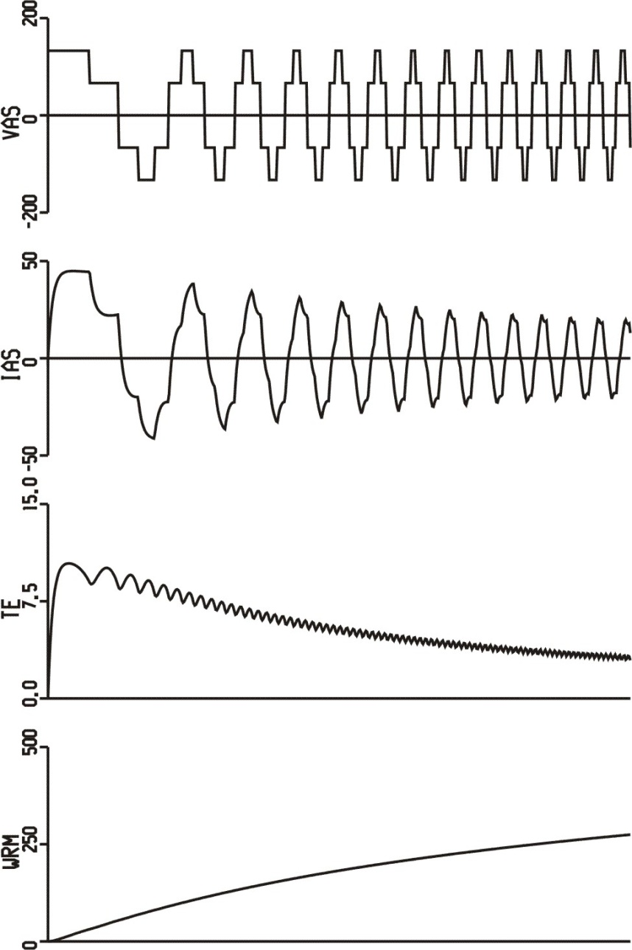
Start-up Study with 180º VSI Drive

Slide 8

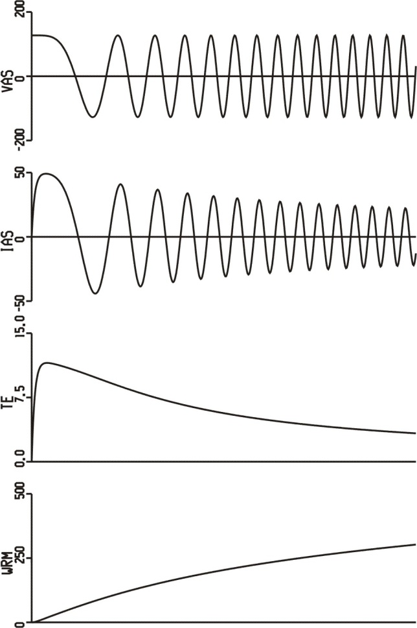
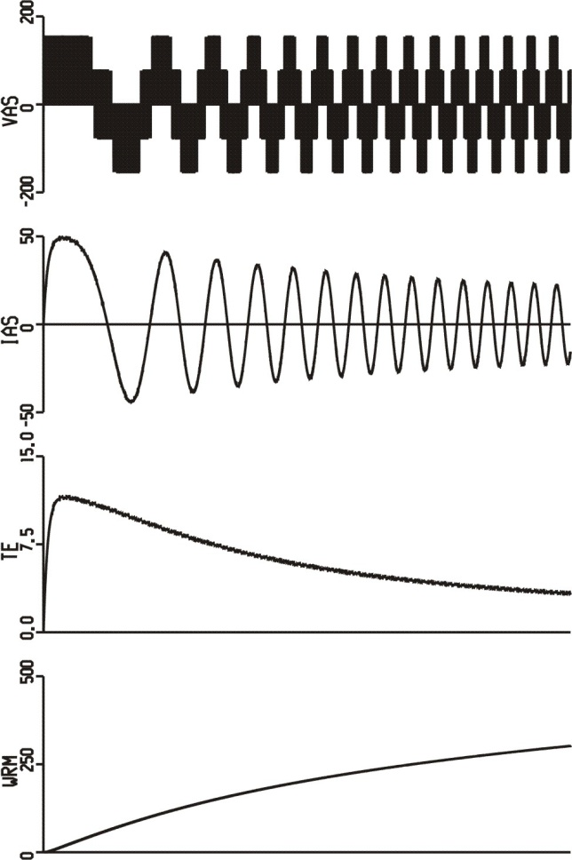
Dynamic Study
180º VSI
ideal drive
sine-triangle

Slide 9
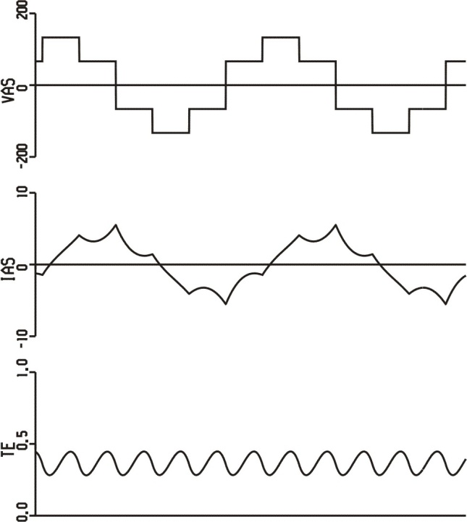
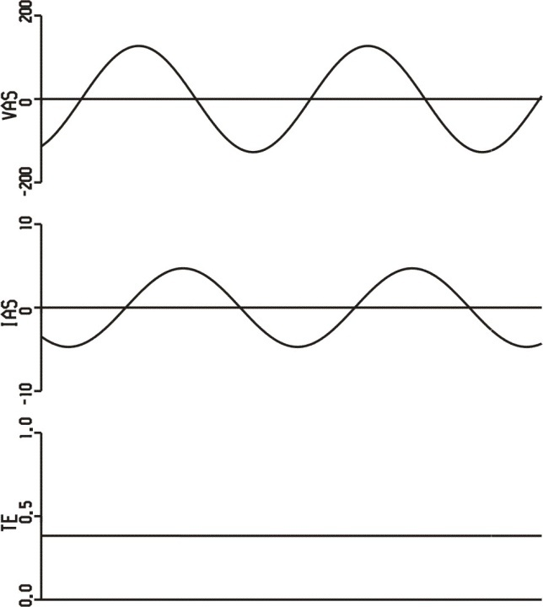
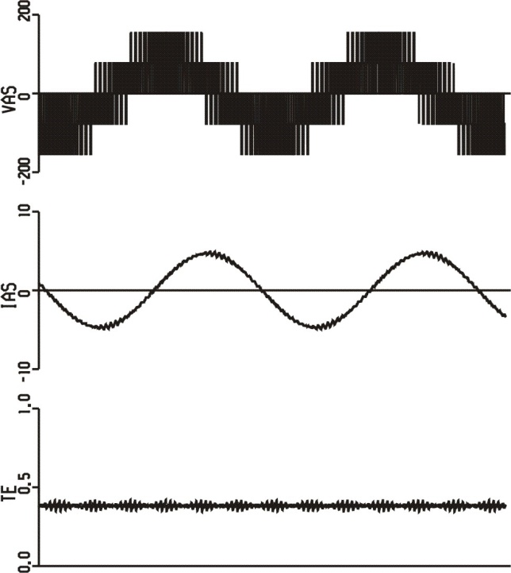
Steady-State Waveforms
180º VSI
ideal drive
sine-triangle

Slide 10
Ideal BDC Drive in PSCAD
BDC_Ideal.psc

Slide 11
PMSM Mechanical Model
BDC_Ideal.psc

Slide 12
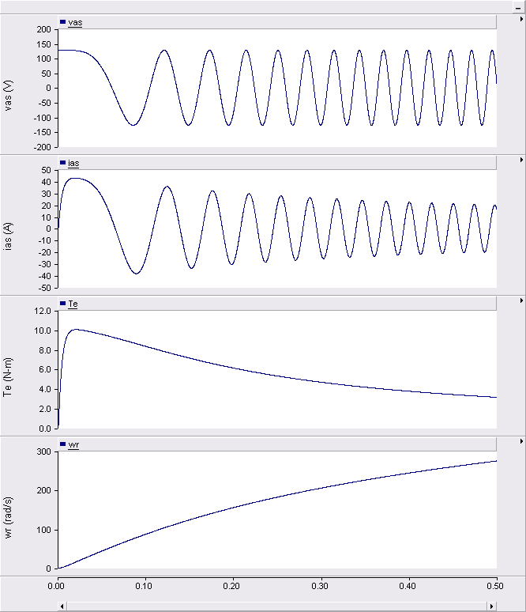
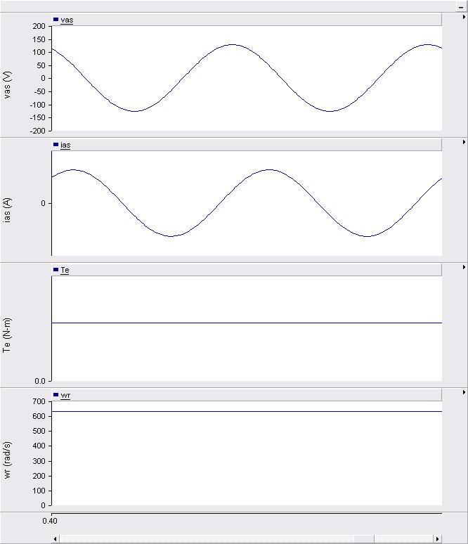
Ideal BDC Drive waveforms
start-up
steady-state

Slide 13
180º VSI BDC Drive in PSCAD
BDC_180_VSI.psc

Slide 14
180º VSI Transistor Switching
BDC_180_VSI.psc

Slide 15
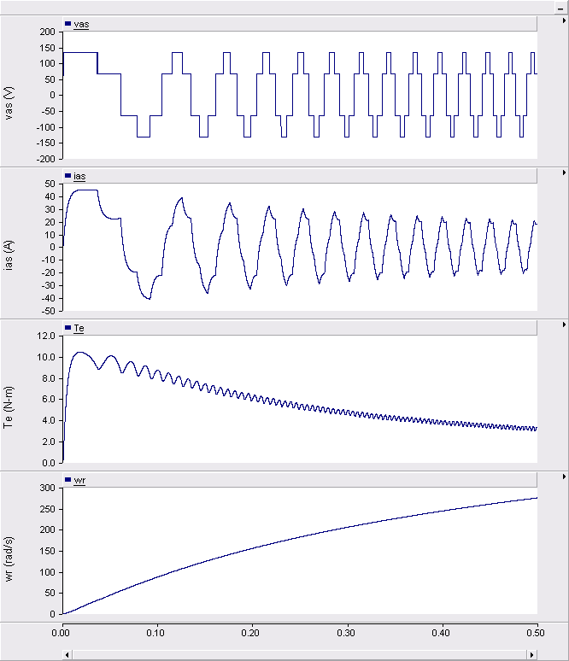
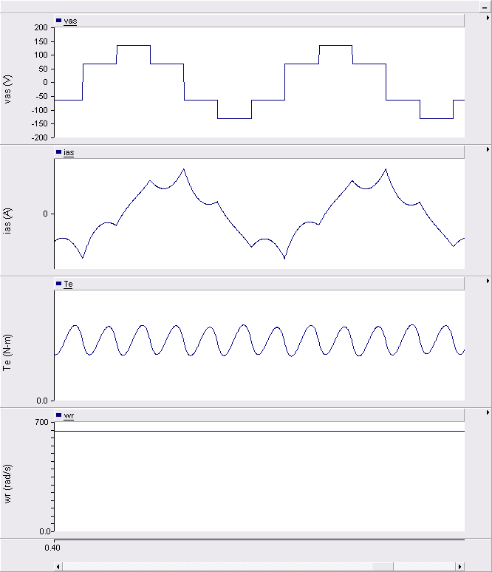
180º VSI BDC Drive waveforms
start-up
steady-state

Slide 16
Sine-Triangle BDC Drive in PSCAD
BDC_sine_triangle.psc

Slide 17
Sine-Triangle Transistor Switching
BDC_sine_triangle.psc

Slide 18
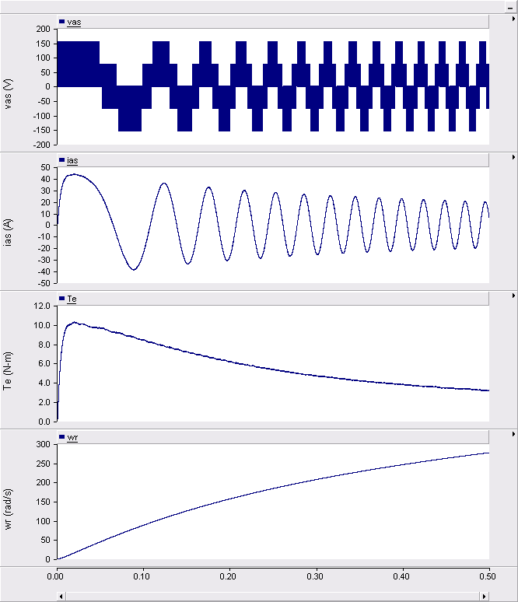
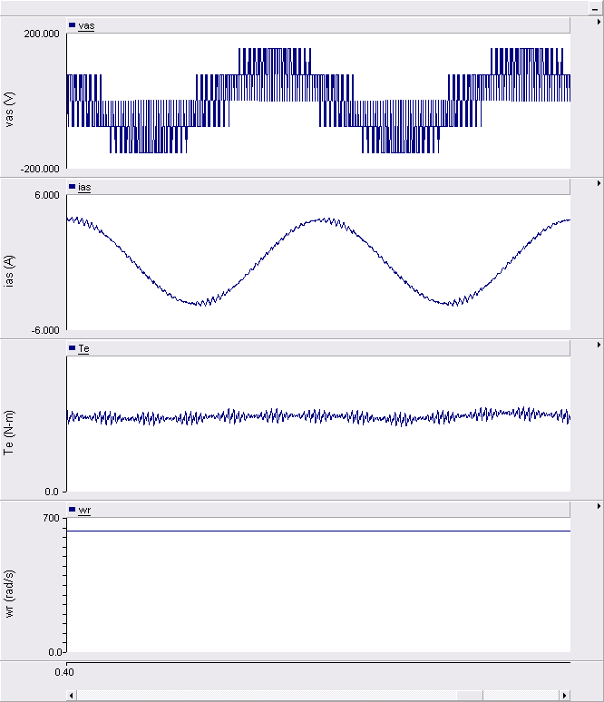
Sine-Triangle BDC Drive waveforms
start-up
steady-state

Slide 19
Brushless Dc Motors
Rotor position sensing, inverter, and control operate in a similar manner to commutator of a traditional dc machine
180 degree VSI and sine-triangle switching schemes demonstrated
Steady-state and transient-state operation are similar to traditional dc machines

Slide 20
Practical BDC Motor Example
Taken from PMSM datasheet
Type: 3-phase, wye-connected PM motor
Parameters (at 25C)
Pole Pairs = 19
PM Flux Linkage (rms def’n) = 0.05 Wb.turns
Phase Resistance = 0.01 Ohms
D-Axis Inductance (PM axis) = 10.0e-5 Henries
Q-Axis Inductance = appr. same
Ratings
Torque = 400 Nm
Current = 141 Arms/phase
Voltage = 105 Vrms/phase
Speed = 1000 rpm
Mechanical Power = 55 HP
Stator Temp = 100C
Rotor Temp = 24C

Slide 21
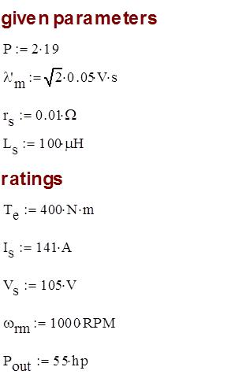
Practical BDC Motor Parameters

Slide 22
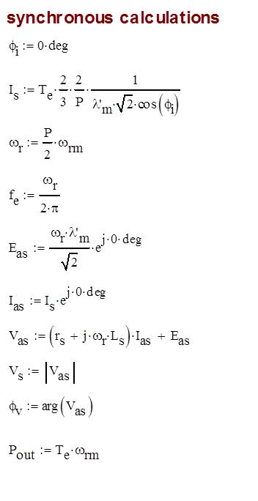
Practical BDC Motor Calculations

Slide 23
Practical BDC Motor Example
Motor datasheet information may be given in a different form than what is in the book
Pole pairs instead of poles
RMS instead of peak values
English units instead of metric
Usually, the parameters and operating conditions can be verified with the given data

Slide 24
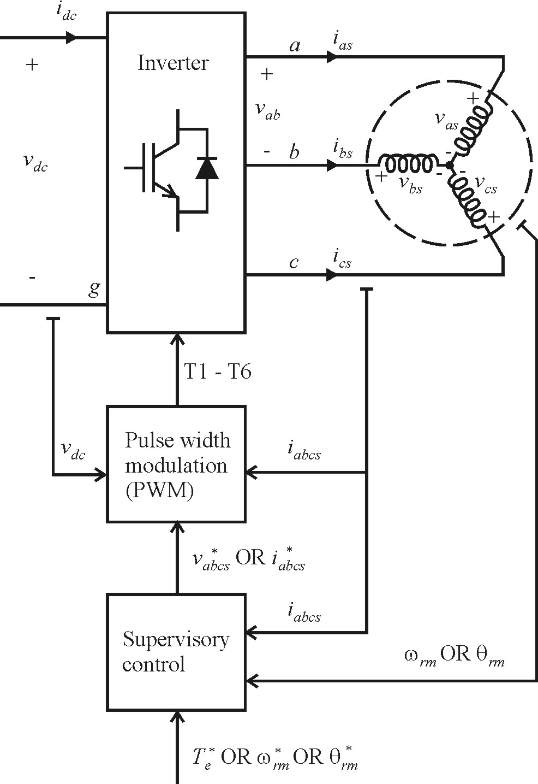
General Ac Drive System Structure
PWM control
switch level control
nanosecond / microsecond time scale
"hardware manager"
usually implemented in PLD
Supervisory control
overall drive system control
microsecond time scale
"application manager"
usually implemented in DSP

Slide 25
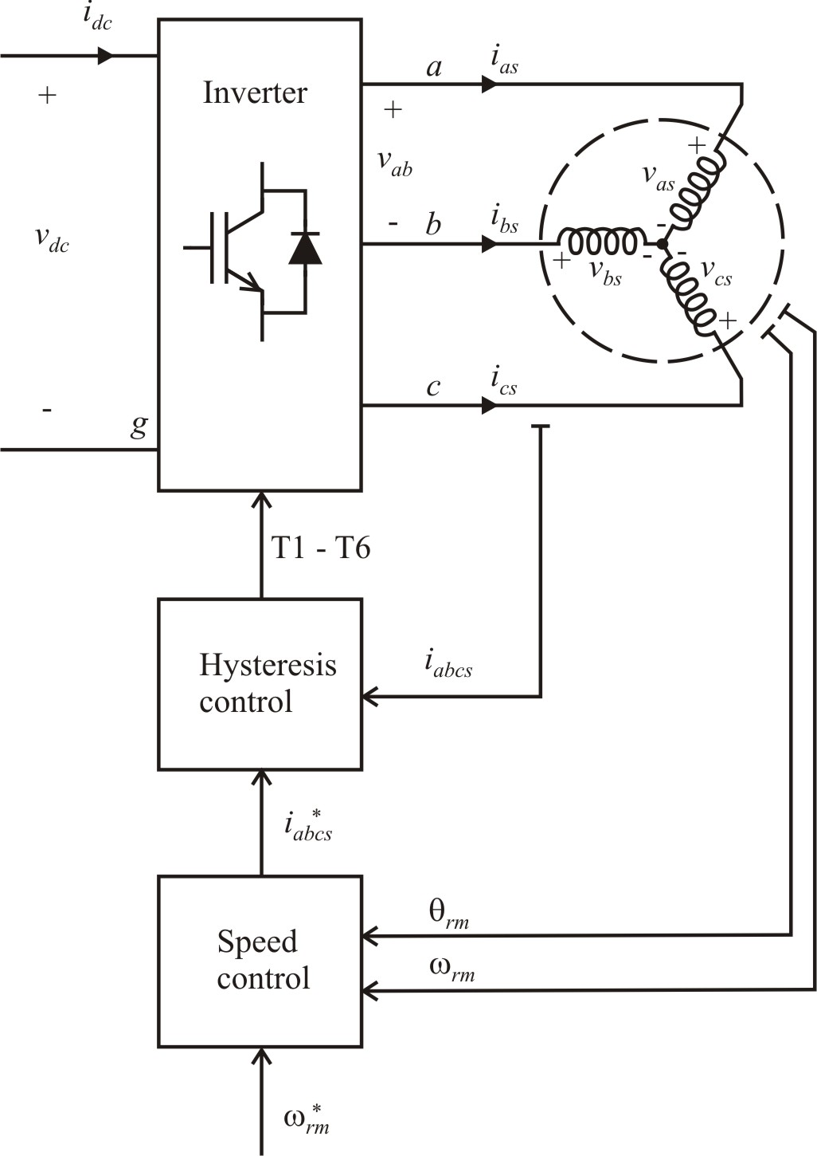
Brushless Dc Drive with Current Regulation
PMSM motor
hysteresis modulation
current regulation with φ_{i} = 0
speed control: PI
vehicle system
see book Figure 15.13-1

Slide 26
Vehicle Calculations

Slide 27
Steady-State Vehicle Calculations

Slide 28
PMSM Equations

Slide 29
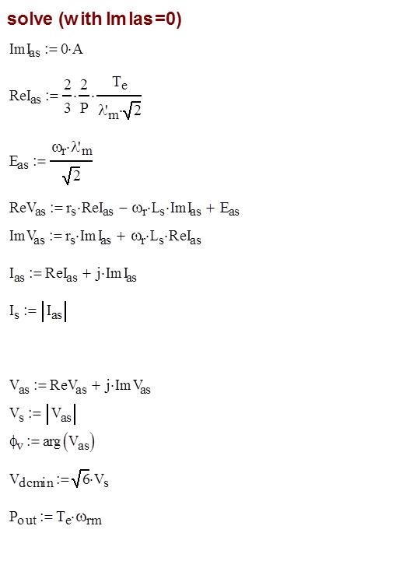
PMSM Calculations (φ_{i} = 0)

Slide 30
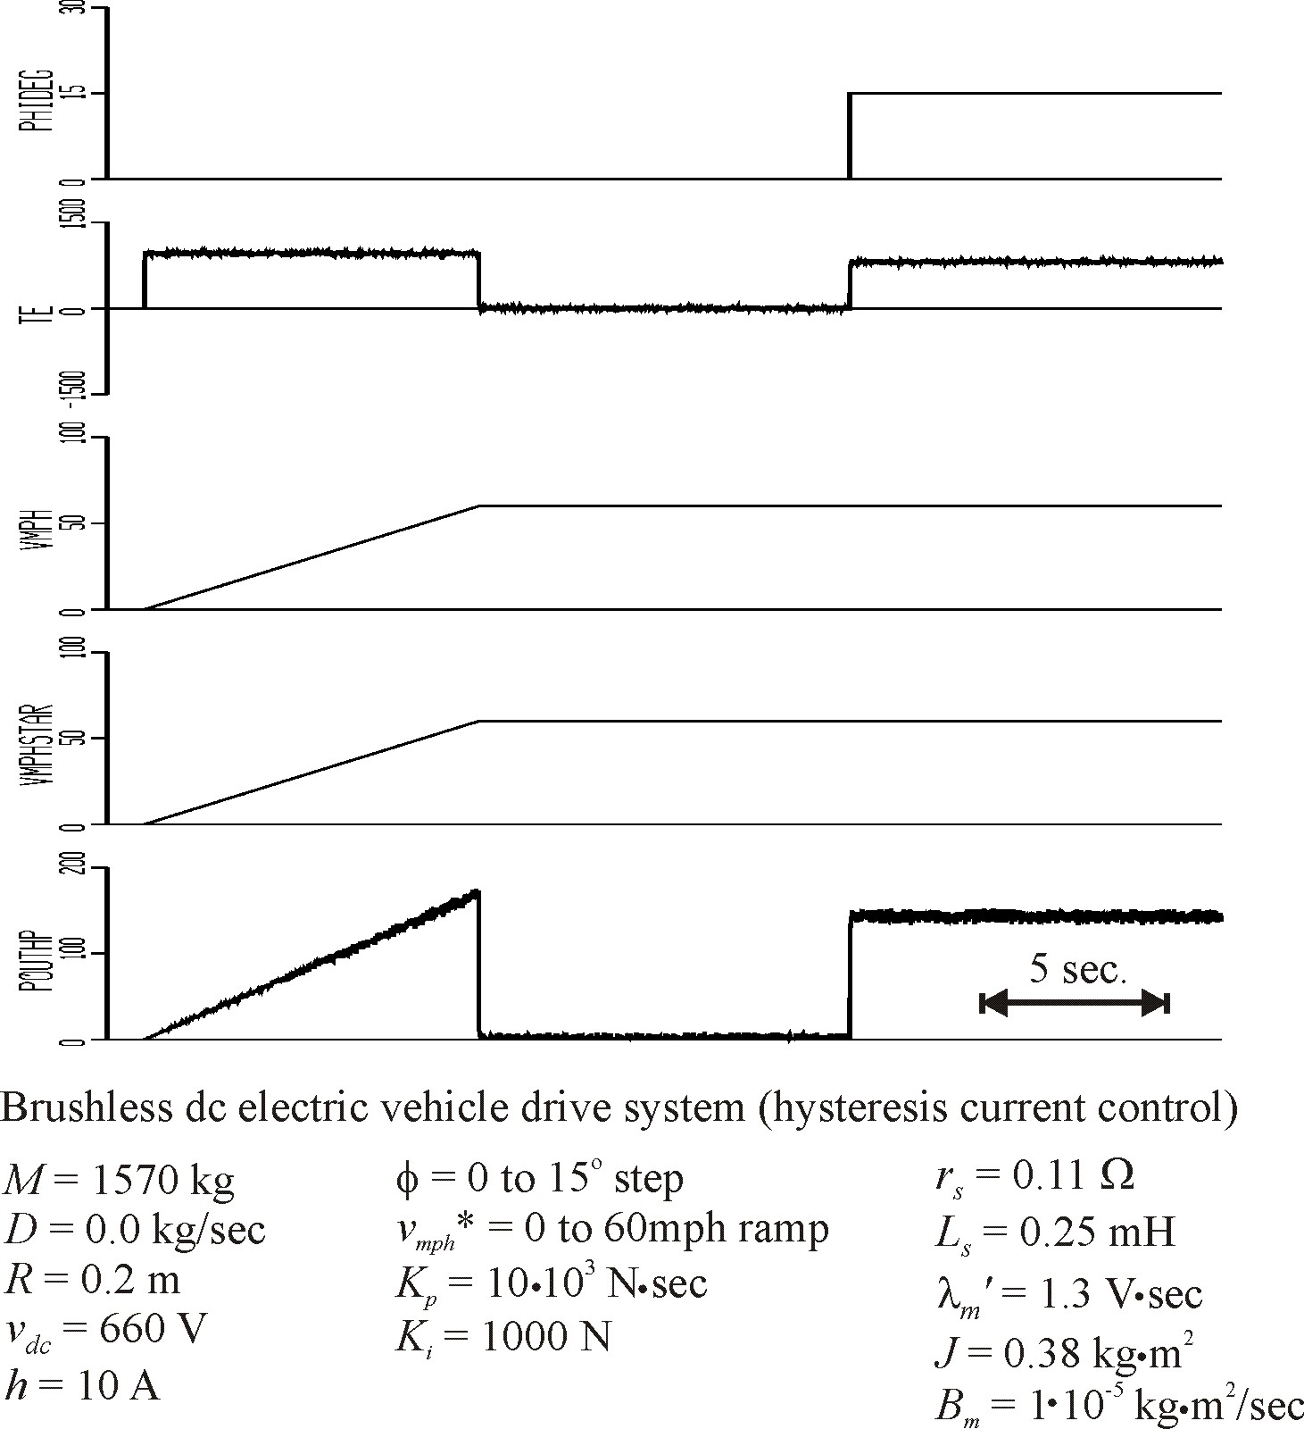

Slide 31
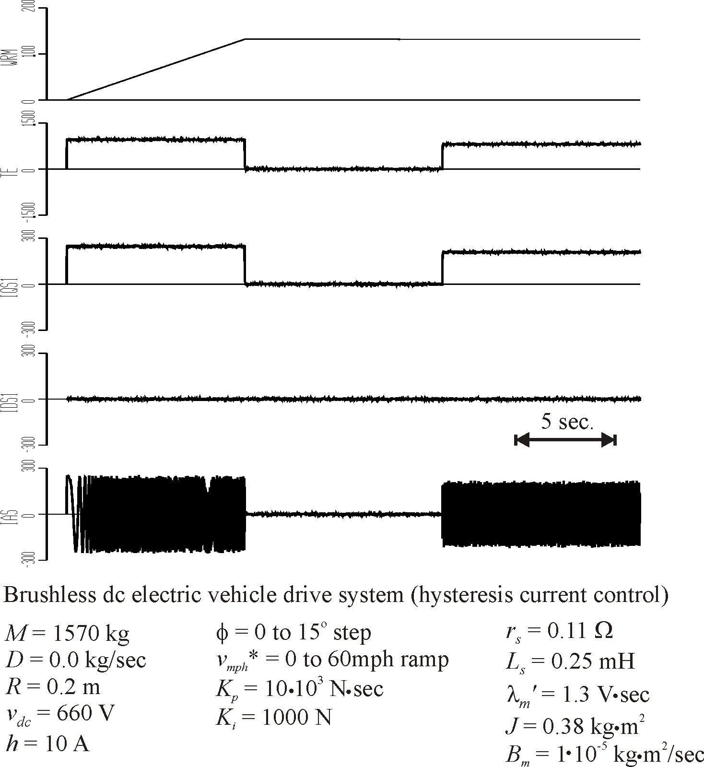

Slide 32
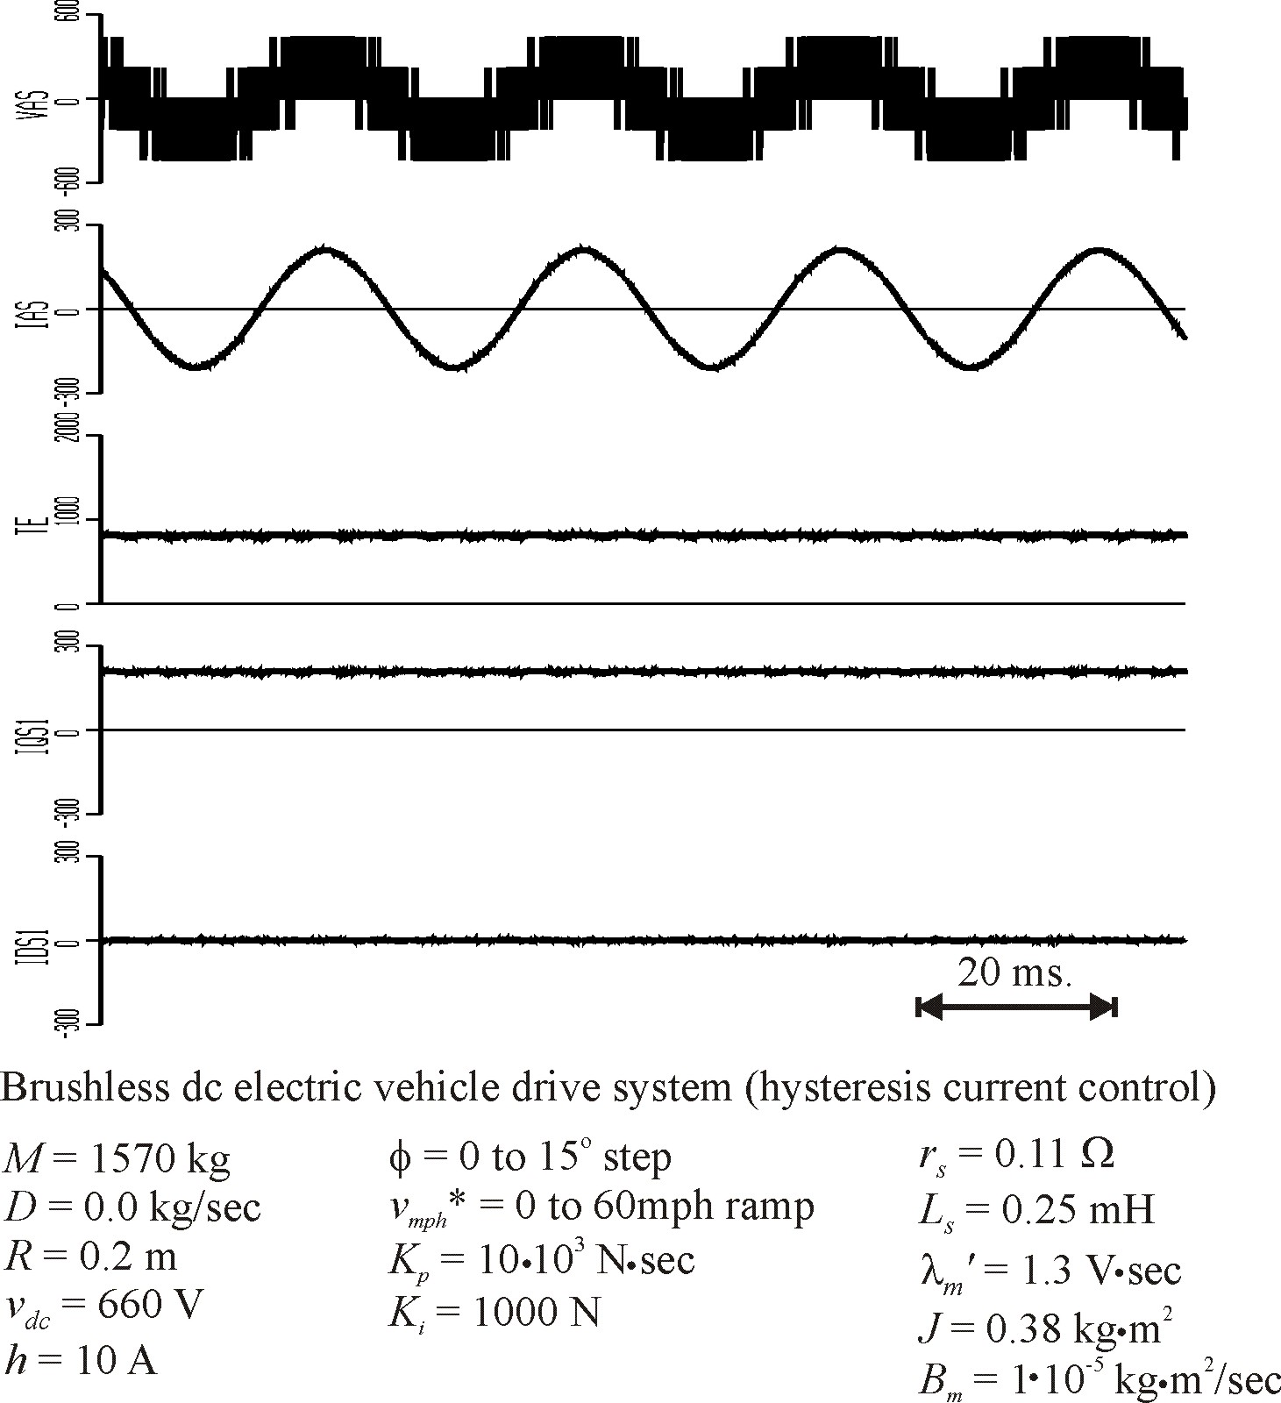

Slide 33
Current-Regulated Drive with Speed Control
An effective brushless dc drive was created by using hysteresis current-regulated PWM
Steady-state and dynamic simulation demonstrate the control

Slide 34
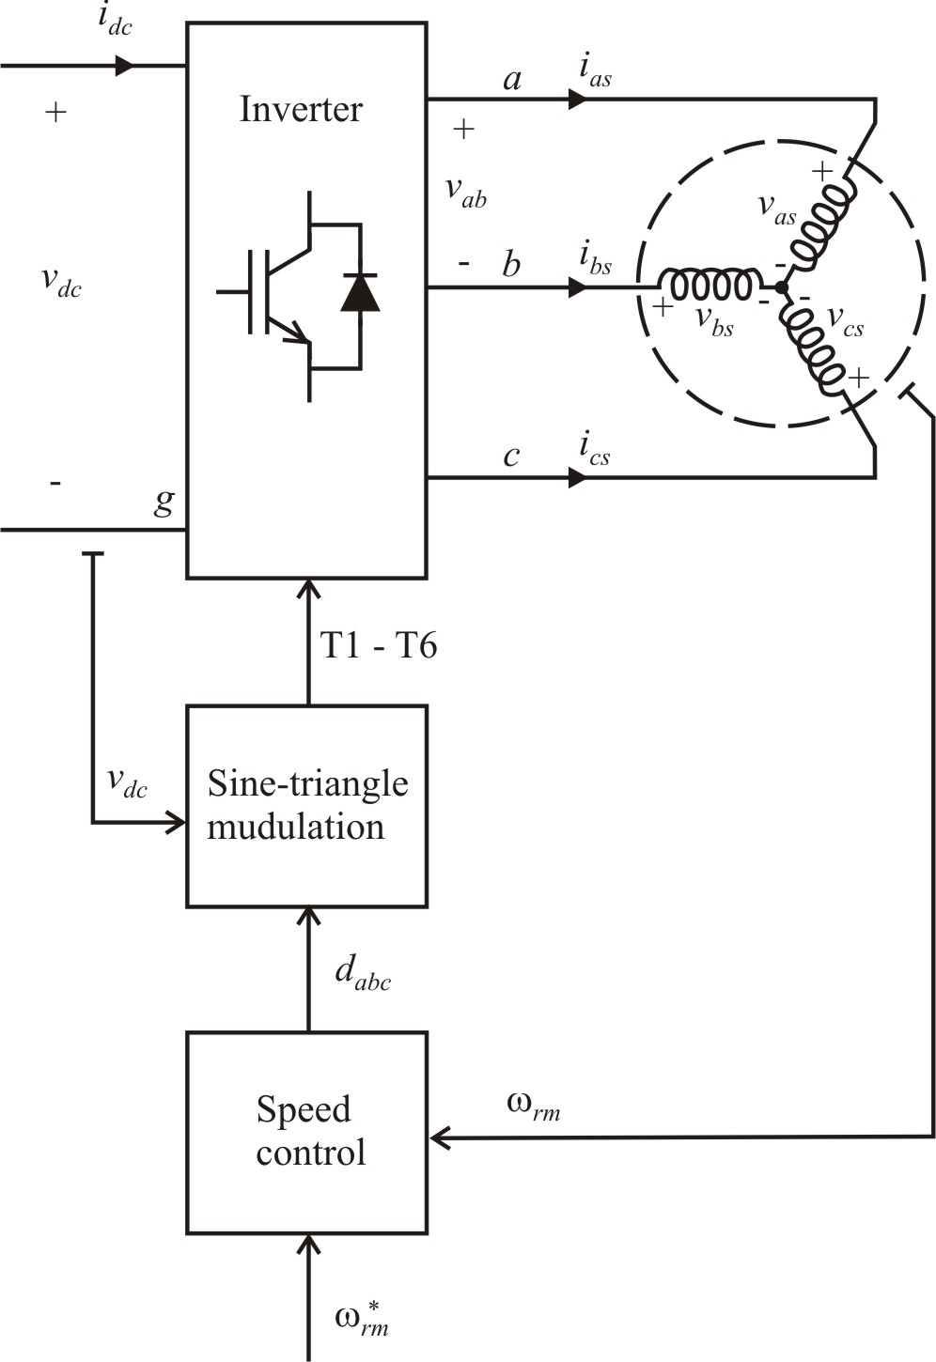
Brushless Dc Drive with Voltage Source PWM
PMSM motor
sine-triangle modulation
voltage regulation: φ_{v} = 0
speed control: PI
vehicle system

Slide 35
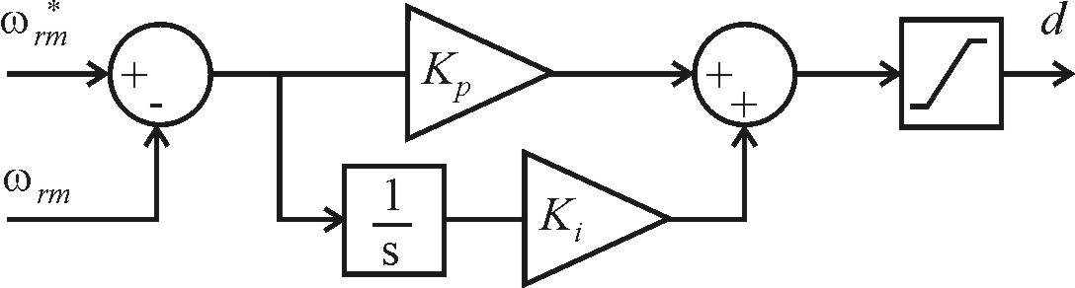
Voltage Control with φ_{v}=0
effectively makes
however,
see book Figure 15.8-1

Slide 36
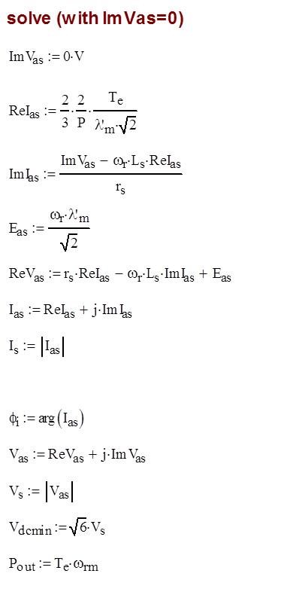
PMSM Calculations (φ_{v} = 0)

Slide 37
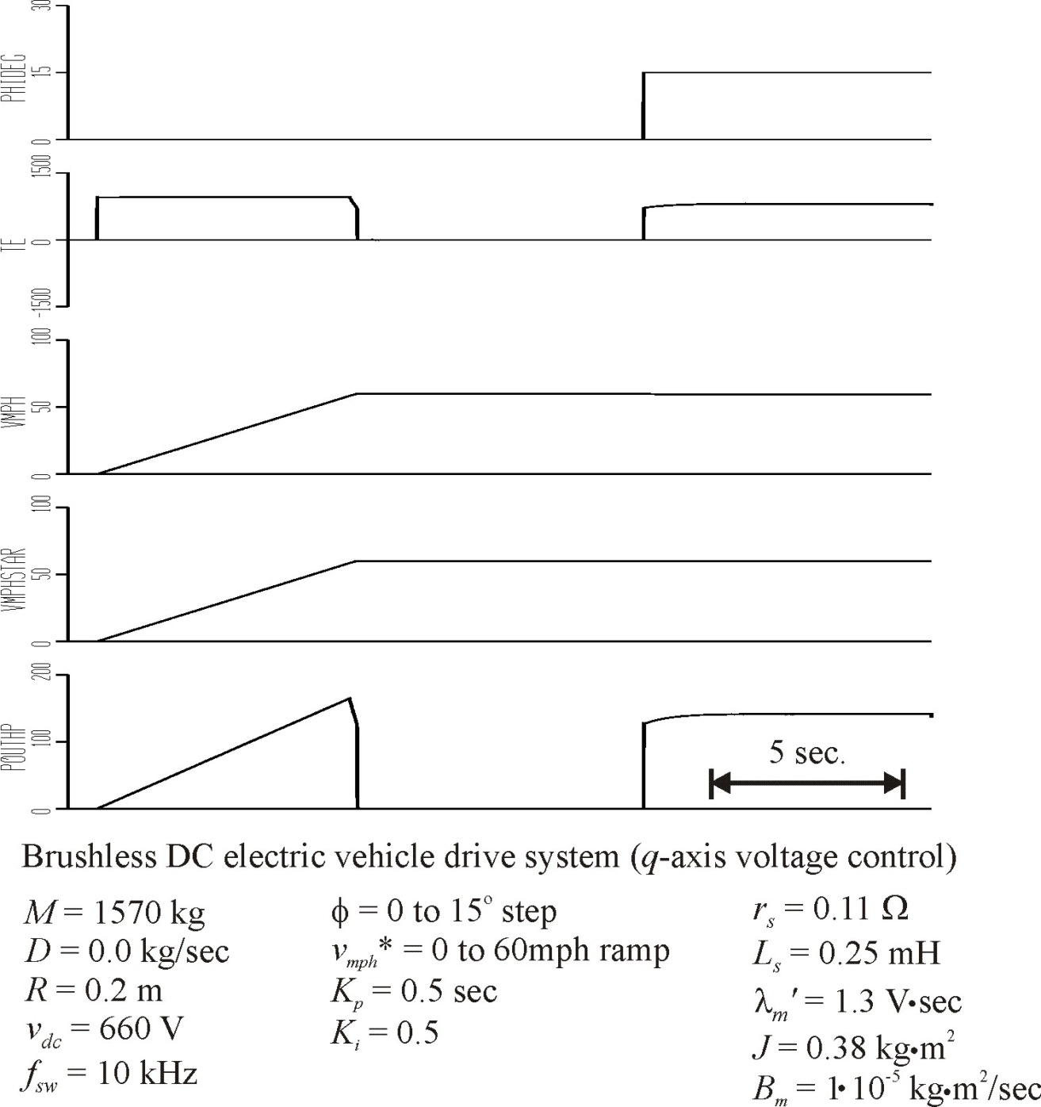

Slide 38
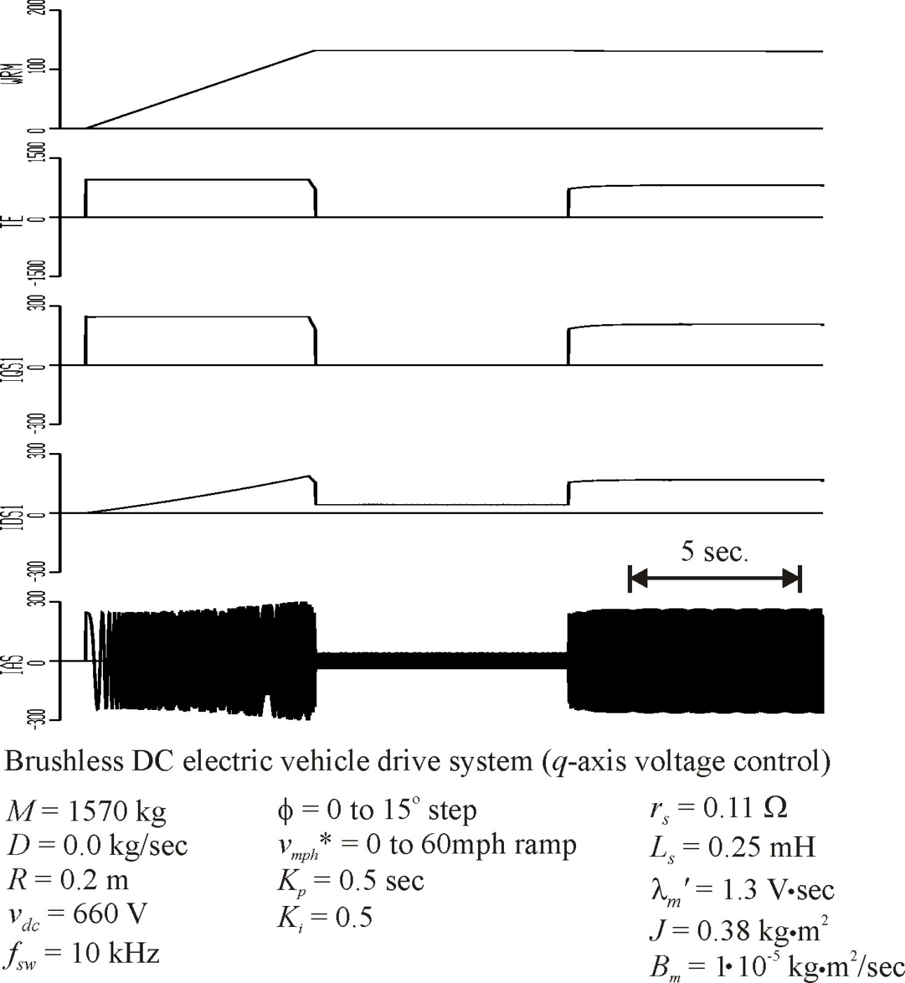

Slide 39
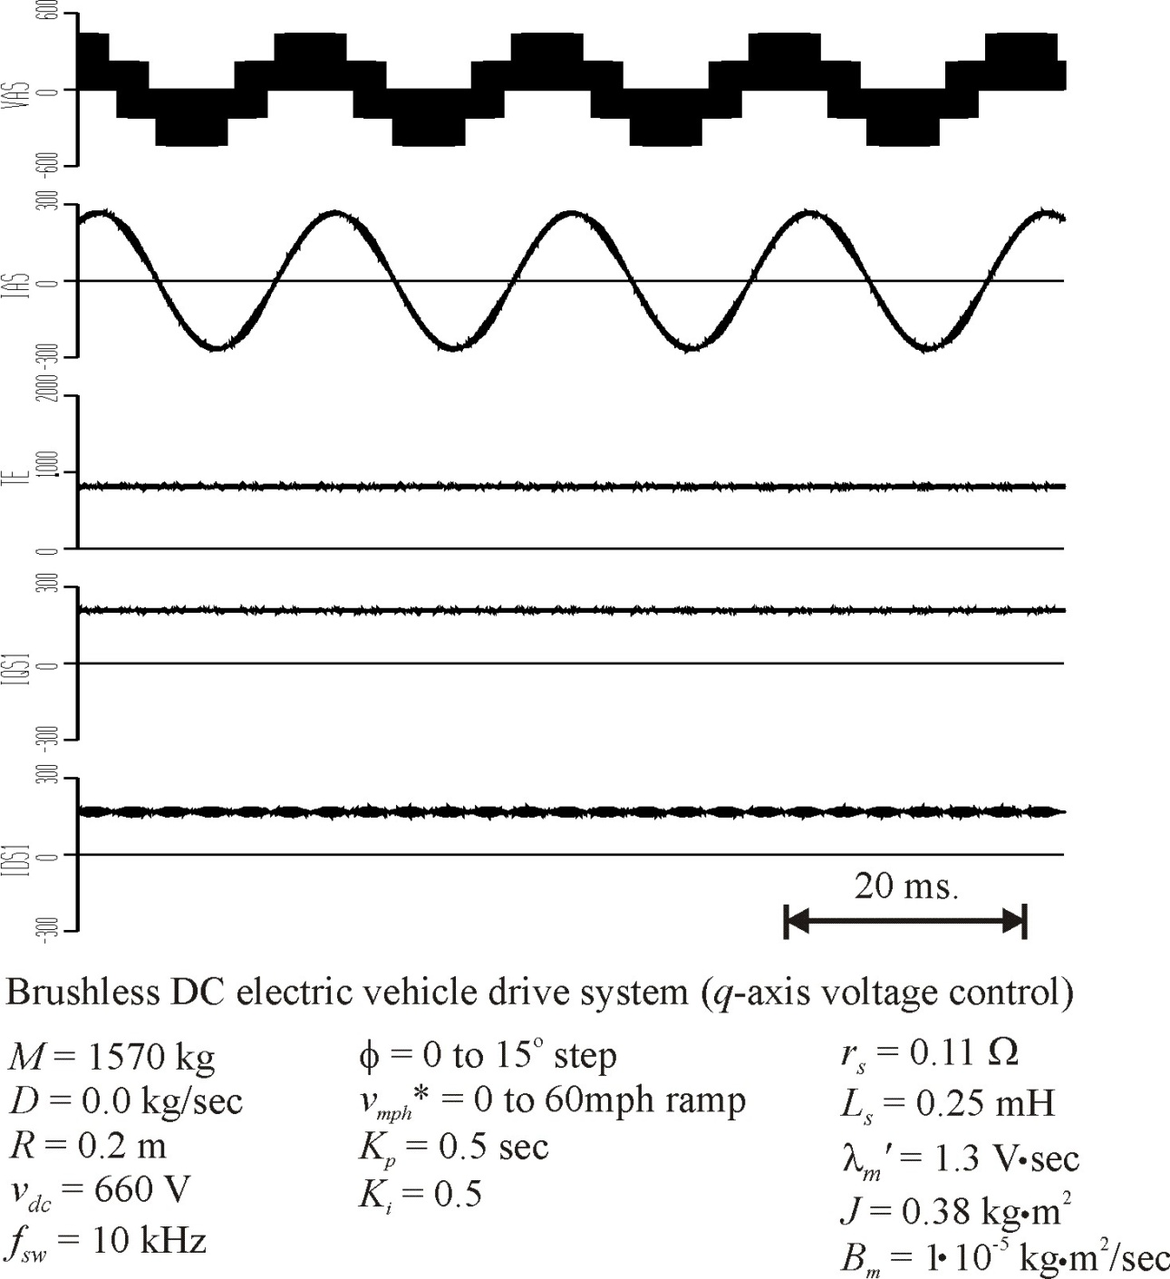

Slide 40
Voltage-Source Drive with Speed Control
The sine-triangle PWM method is preferred in many drive applications because of better harmonic performance and consistent switching frequency
One method of utilizing voltage-source PWM is to make the modulation index proportional to commanded torque. This method places the stator voltage in the q-axis and does not yield maximum torque per amp.

